Slide 1
Spring Microservices

Slide 2
Application architecture
Monolith
Microservices

Slide 3
Monolith
One big single program
Independent
Self-contained
At one point its difficult to maintain

Slide 4
Microservices
A lot of small programs which communicate with each other
Hard to start
Maintain isn’t depend on whole system complexity
Faster development than monolith in the long run

Slide 5
Netflix stack
Millions watchers
PBs of streaming data
It is not known what will happen next

Slide 6
Spring boot
Originally was designed for microservices (think about it)
Full support of NS
Even Netflix uses Spring boot

Slide 7
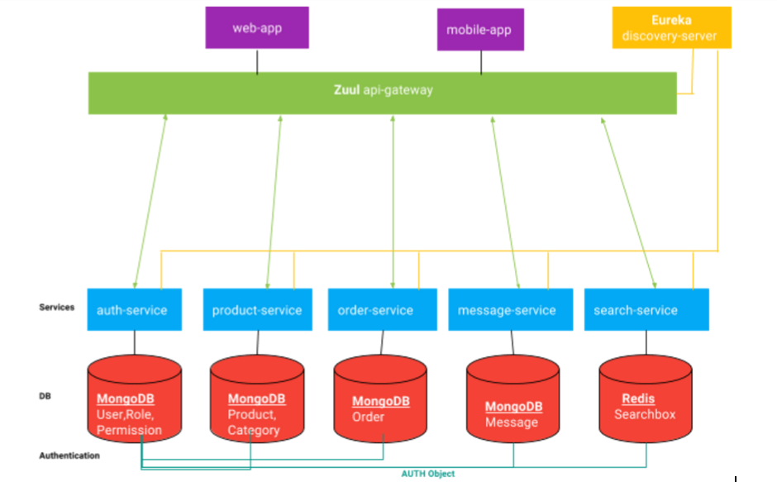
Diagram

Slide 8
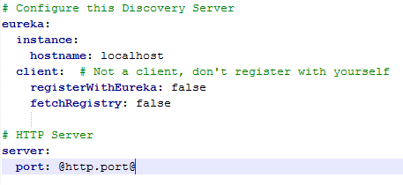
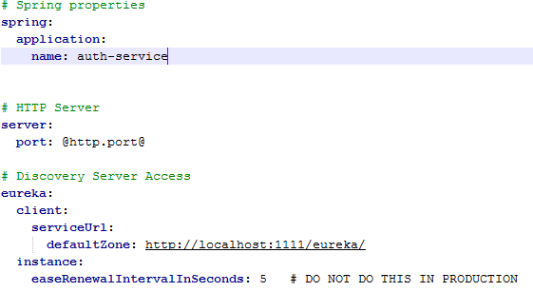
Eureka
Create a simple spring boot app and add @EnableEurekaServer
Add next config
Add @EnableDiscoveryClient to your MicroService
Add next config

Slide 9
Config
@EnableConfigServer and provide git repository URI in config
On client add spring.cloud.config.uri=CONFIG_URI
Use @RefreshScope to refrech configs

Slide 10
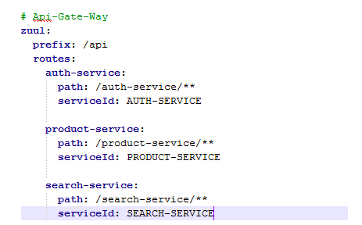
Zuul

Slide 11
Communication
Use @FeignClient to get URL from Eureks
You can also use the custom configuration

Slide 12
Security
JSESSIONID
JWT

Slide 13
JWT
Header | { "alg" : "HS256", "typ" : "JWT" } | Identifies which algorithm is used to generate the signatureHS256 indicates that this token is signed using HMAC-SHA256. Typical cryptographic algorithms used are HMAC with SHA-256 (HS256) and RSA signature with SHA-256 (RS256). JWA (JSON Web Algorithms) RFC 7518 introduces many more for both authentication and encryption.^{[9]}
Payload | { "loggedInAs" : "admin", "iat" : 1422779638 } | Makes claims. In this example there is a custom field claiming the user is "loggedInAs" an "admin".As suggested in the JWT spec, the payload may include other standard fields, such as iat (issued at timestamp) ^{[1]}
Signature | HMAC-SHA256( encodeBase64Url(header) + '.' + encodeBase64Url(payload), secret ) | Securely validates the token. The signature is calculated by base64url encoding the header and payload. Base64url encoding the secret is optional. The resulting string is concatenated with a period separator, and then run through the cryptographic algorithm specified in the header, in this case HMAC-SHA256.

Slide 14
Inverted index
Given: T0 = “it is what it is”; T1=“what is it”;T2=“it is a banana”
"a": {2}
"banana": {2}
"is": {0, 1, 2}
"it": {0, 1, 2}
"what": {0, 1}

